Slide 1

PS-2 Customer Churn Prediction using ML.

Slide 2

KESHAV MEMORIAL INSTITUTE OF TECHNOLOGY
Accredited by NBA & NAAC, Approved by AICTE,
Affiliated to JNTUH, Hyderabad
3-5-1026, Narayanguda, Hyderabad-29.
Guide
Ms.S.Swaraja Laxmi
Associate Professor
Department of Information Technology
Project Team Members
Project Team Members Roll numbers
CH.Srisai 19BD1A1213
K.Harsha Vardan 19BD1A1226
N.Amith 19BD1a1232
Sk.Inthiyaz 19BD1A1245

Slide 3
CONTENTS
ABSTRACT
INTRODUCTION
SYSTEM REQUIREMENTS
UML DIAGRAMS
IMPLEMENTATION DETAILS
SCREENSHOTS
INTEGRATION
CONCLUSION
REFERENCES

Slide 4
Abstract
Customer churn analysis and prediction in telecom sector is an issue now a days because it’s very important for telecommunication industries to analyze behaviors of various customer to predict which customers are about to leave the subscription from telecom company.
So machine learning techniques and algorithm plays an important role for companies in today’s commercial conditions because gaining a new customer’s cost is more than retaining the existing ones.
This project focuses on various machine learning techniques for predicting customer churn through which we can build the classification models such as Logistic Regression, Random Forest and lazy learning and also compare the performance of these models

Slide 5
INTRODUCTION
In a retail sector business, some customers stick around while others stop shopping at a particular store after certain period of time.
Detecting which customers have decided to shop elsewhere and which ones are idle at the moment, is a Herculin’s task for a company.
Customer churn is the tendency of customers to stop purchasing with a company over a time period.
Customer churn is also called customer attrition or customer defection.
Churning impedes growth. Therefore, companies should have a proper defined method to compute customer churn rate for a given time.
By keeping track of churn rate, organizations can be equipped to success rate in terms of customer retention.

Slide 6
EXISTING SYSTEM
Despite the existence of many systems which can analyse the customer data and derive valuable insights from it like the factors affecting the customer churn, it becomes difficult to predict whether a particular customer would churn in the near future based on his characteristics in real time.
The existing systems use exploratory data analysis to understand the data and the companies have to take decisions based on these insights.
It is important for the companies to know specifically which customer is going to churned which customers are loyal customers so that the companies could take measures to retain the potential churners.
It is also important to use an efficient algorithm for this prediction.

Slide 7
Proposed System
Though we can act upon the insights provided by the exploratory data analysis alone to take measures to retain the customers, much more effective measures can be formulated if the system is able to predict the particular customer who would potentially churn.
The predictive model needs to have a suitable machine learning algorithm to predict the churn value accurately. So it is important to check the compatibility of the algorithm being used by comparing the accuracy the model by using different algorithms.
Thus, the solution is to train various machine learning algorithms with the customer data and compare the results and choose the best algorithm for the customer churn prediction

Slide 8
SYSTEM REQUIREMENTS SOFTWARE REQUIREMENTS
The basic requirements to run our software in the system are called software requirements. Our project is customer churn prediction system which require the environment to develop the code which perform Prediction
Visual studio(or any other Ide to run the code)
Open cv
Sheets
Data base storage
HARDWARE REQUIREMENTS
4BG RAM
I3 Processor
Internet connection

Slide 9
FUNCTIONAL REQUIREMENTS AND NON FUNCTIONAL REQUIREMENTS
FUNCTIONAL REQUIREMENTS
Prediction of churn value
Prediction of churn rate for given period
Helps to visualize best buying patterns
Helps in creating better strategies for customer drops
NON FUNCTIONAL REQUIREMENTS
Robustness
Security
Modular
Compatibility etc.

Slide 10
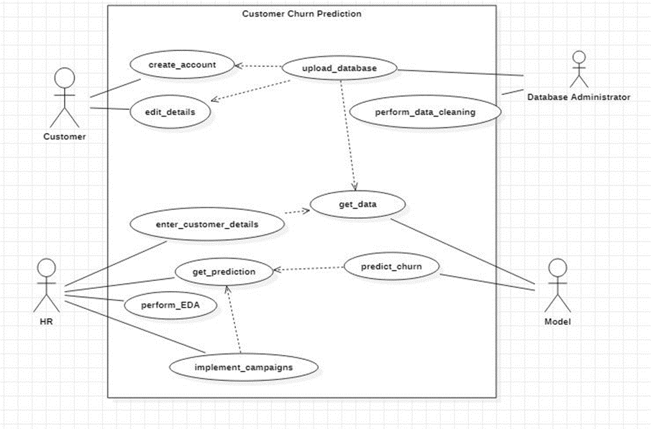
UML DIAGRAMS Use case Diagram

Slide 11
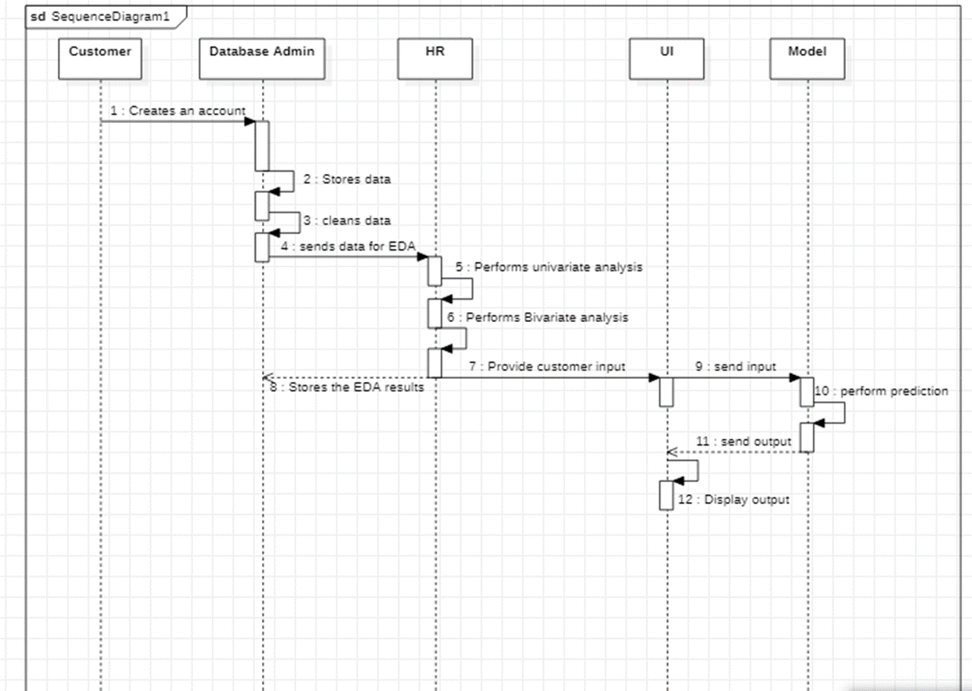
Sequence Diagram

Slide 12
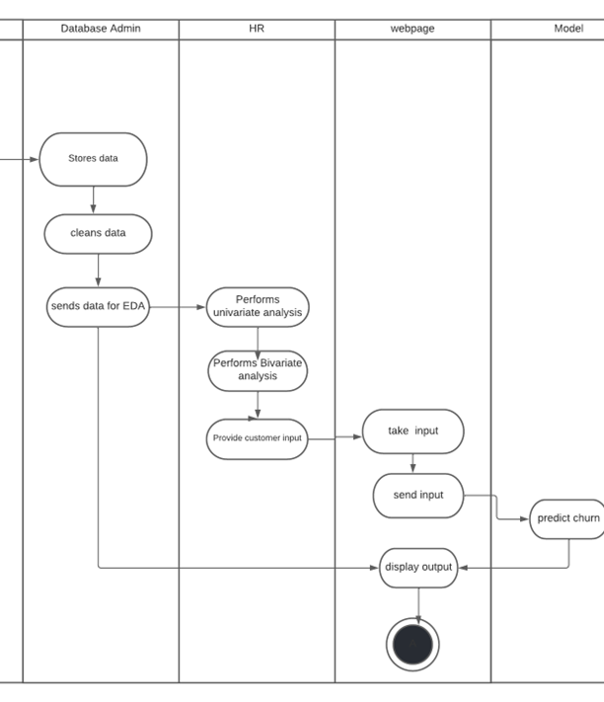
Activity diagram

Slide 13
IMPLEMENTATION DETAILS

Slide 14
IMPLEMENTATION DETAILS

Slide 15

SCREENSHOTS
Fig1 Login Page

Slide 16
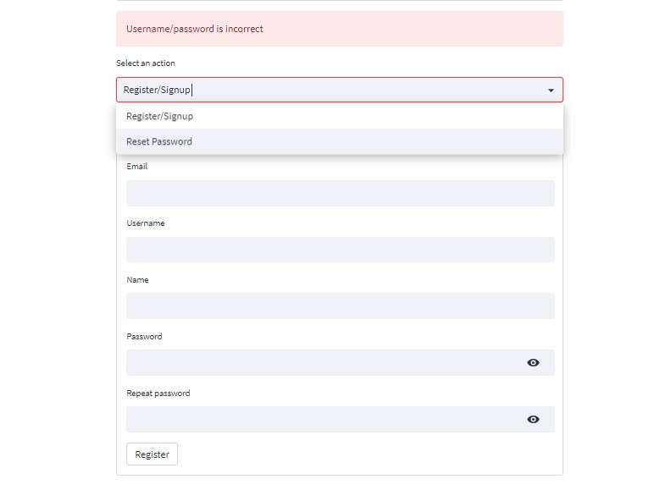
Fig2 New User Registration Page(signup page)

Slide 17
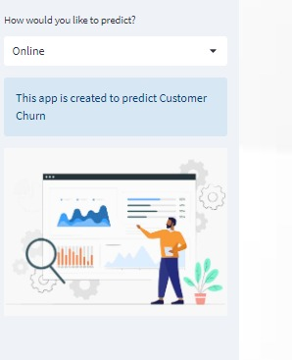
Fig3 Home UI

Slide 18
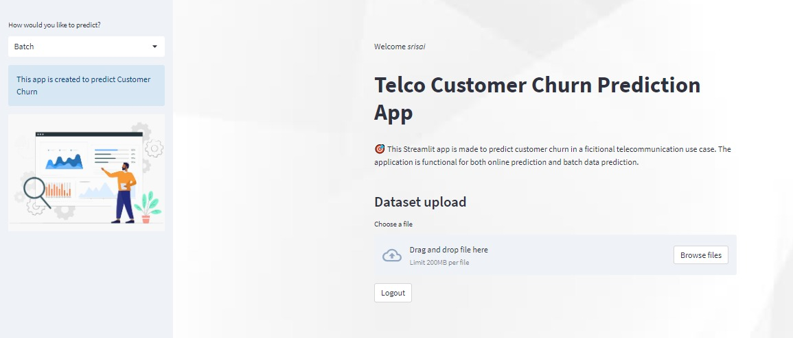
Fig3.1 Home UI

Slide 19
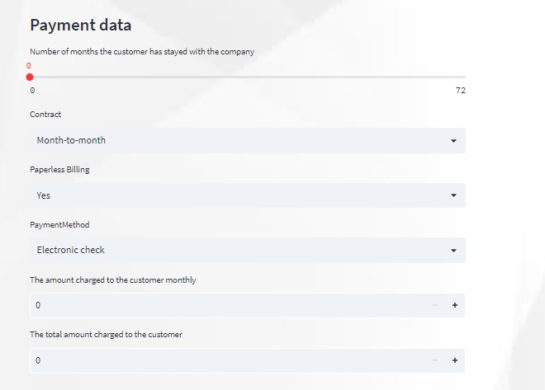
Fig4 Payment data of customer

Slide 20
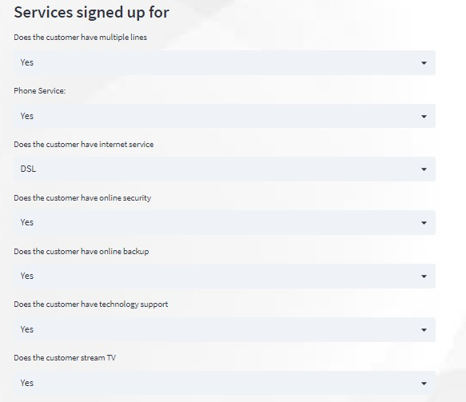
Fig5 Customer Data Fields

Slide 21
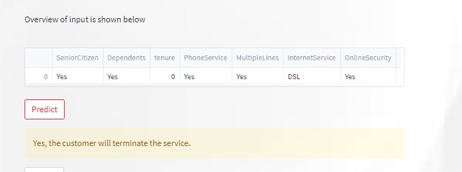
Fig6 OverView of Input Entered

Slide 22
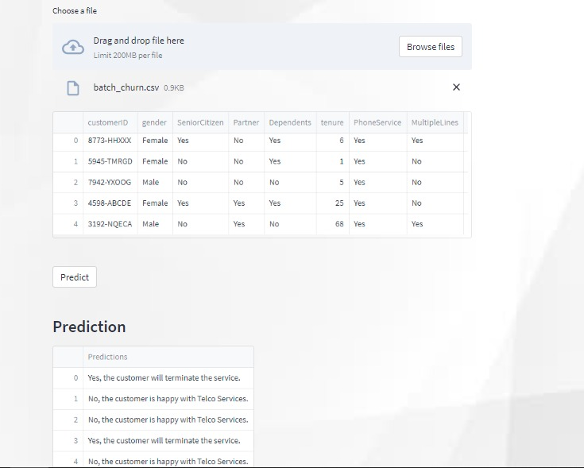
Fig7 OutPut Prediction

Slide 23
INTEGRATION

Slide 24
CONCLUSION
Customer churn prediction plays a very important role in determining the success of any organization. Retaining the already acquired customers is very economical and takes lesser efforts compared to acquiring new customers. So it is very important to have effective mechanisms to analyze customer satisfaction and predict customers who would probably churn.
Finally Random Forest Classifier model achieved high accuracy (94% ) and better prediction of customer churn compared to other four models. We have also observed that factors like subscription model, tenure, monthly charges, total charges, senior citizen have a high impact on the churn where as factors like gender, availability of phone service, having multiple lines does not affect the churn value considerably. This model can be further improved by including techniques to find out why exactly the customer is churning.

Slide 25
REFERENCE

